Slide 1
NFL Health & Safety
Sprint 4
Niko Hildenbrand
Arnaud Harmange

Slide 2
Goals for Sprint 4
Feed our algorithm other data to see the results and continue to fine tune parameters and compare to competition results
Complete the combination of individual frames to create output video with helmet tracking

Slide 3
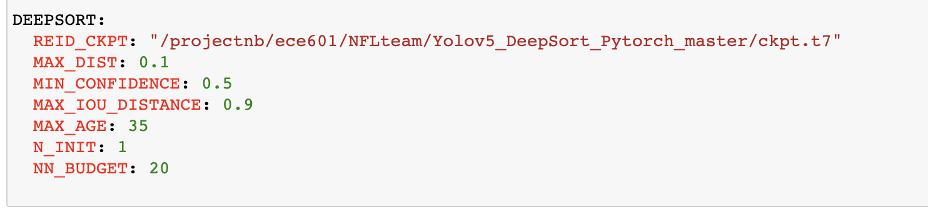
Fine Tuning Parameters
120 mp4 files
Last Sprints Results
Newly Tuned Parameters
Score before = 0.31913
Score after DeepSort = 0.68594
Score before = .4731
Score after DeepSort = .7163

Slide 4
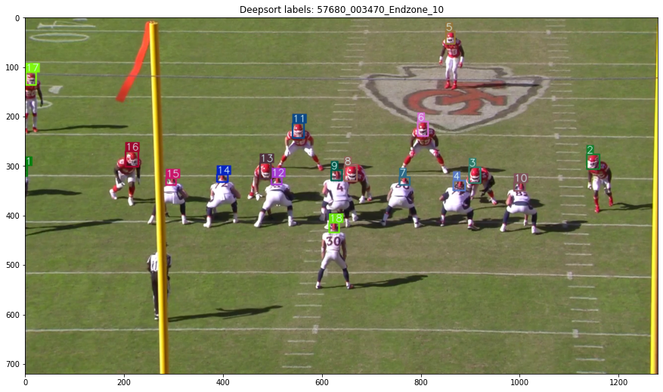
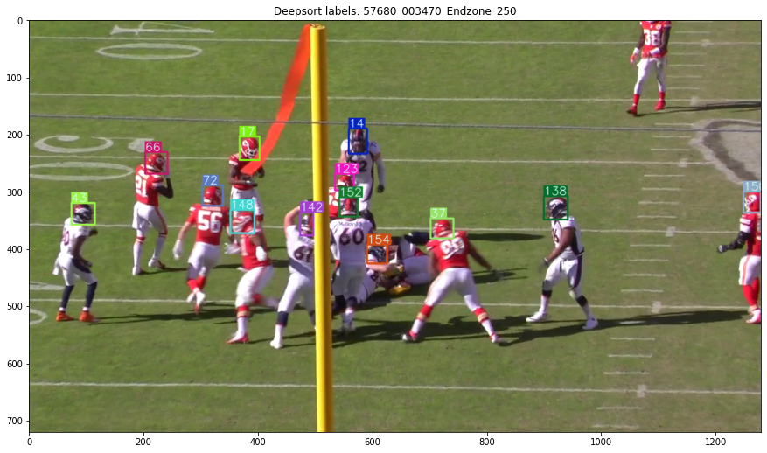
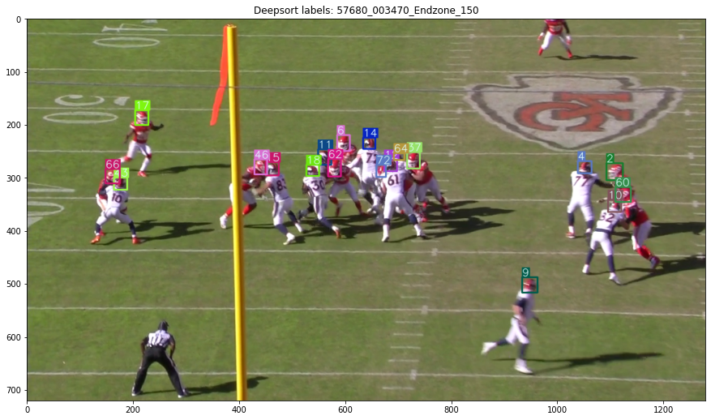
Combining Frames

Slide 5
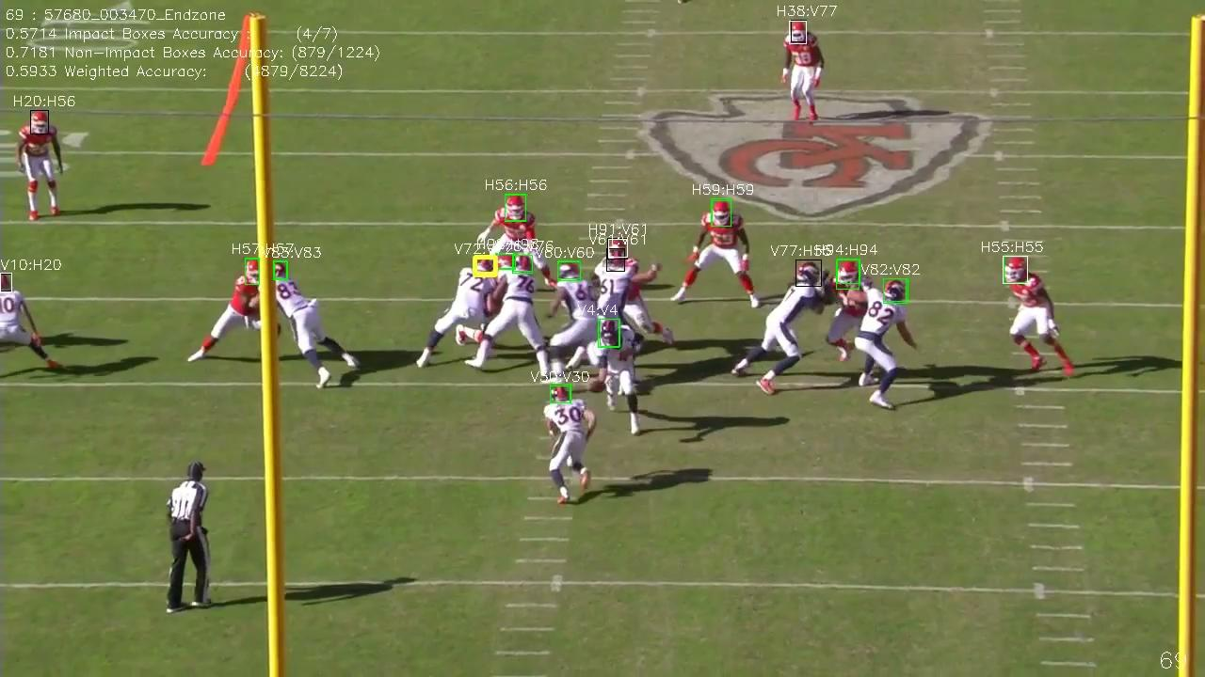
Video Results

Slide 6
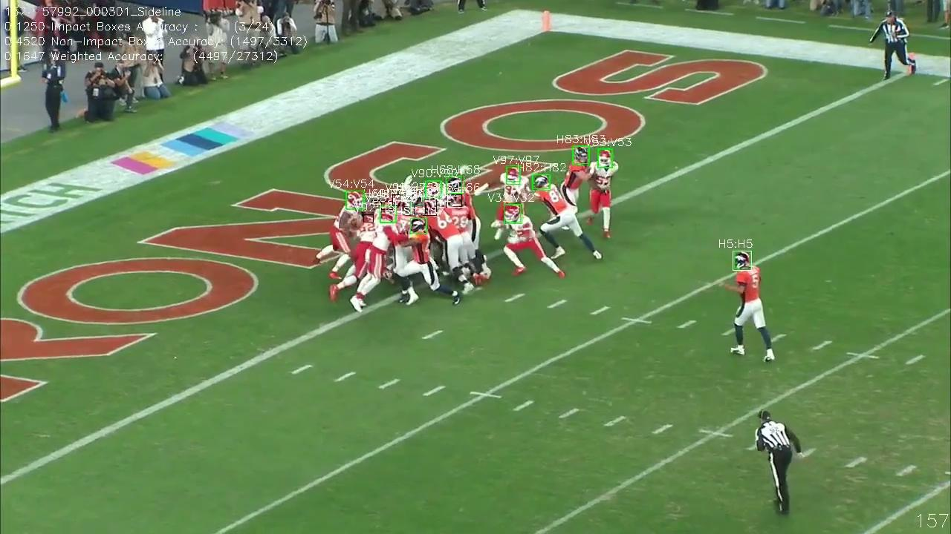
Video Results 2

Slide 7
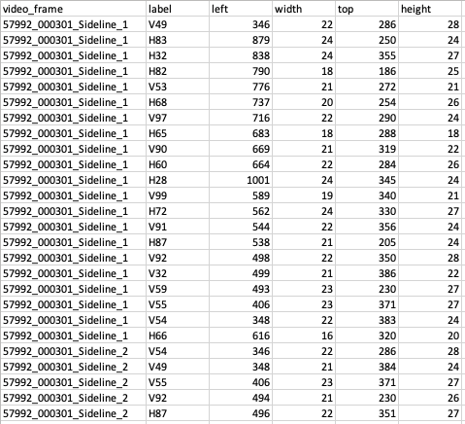
Output CSV file

Slide 8
Goals by Poster Presentation
Continue to test video data to confirm results
Input other mp4 video from other sports
Gain a deeper understanding of which parameters suit which videos

